Slide 1
Item 3. Agree upon the recruitment scenario(s) for the WCNPO striped marlin rebuilding projections
Expected future recruitment strength is a driving variable for stock projections.
WCNPO striped marlin recruitment strength exhibits nonstationarity and this needs to be accounted for in the recruitment model(s) used for the rebuilding analyses.
Setup for the previous rebuilding projection examples in Agenda Item 2 used a combination of 3 distinct recruitment models for WCNPO striped marlin:
Short-term stock recruitment model
Medium-term stock recruitment model
Long-term stock recruitment model

Slide 2
Background: 2023 Striped Marlin Spawning Biomass
Notes:
Stock status is depleted

Slide 3
Recruitment Models

Slide 4
Assessment Recruitment Model for Projections
Long-term recruitment (Beverton-Holt Curve Fitted in Base Case Assessment Model): Random sampling from the expected stock-recruitment curve with lognormal error
Working hypothesis is that recruitment in the next decade will be similar to that from the fitted assessment model during 1977-2020
Long-term recruitment model assumes stationarity of recruitment dynamics in 1977-2020
Modified Beverton-Holt parameters: h = 0.87, R₀ = 405.8, SSB₀ = 19278.8, σ_{R} = 0.6
Mean(Predicted Recruitment) = 301.3 (age-1, 000s)
CV(Predicted Recruitment) = 14%

Slide 5
Recruitment: Long-Term Model

Slide 6
Empirical Recruitment Models for Projections
Short-term recruitment (5-year ECDF): Random sampling from the Empirical Cumulative Distribution Function of recruitment during 2014-2018
Working hypothesis is that recruitment in the next decade will be similar to that observed in the recent past, with a 5-year ECDF of about 1 mean generation time for striped marlin (≈ 5 years)
Similar to short-term recruitment model used in 2020-2021 WCNPO Striped Marlin rebuilding plan analyses
Mean(Recruitment) = 135.4.0 (age-1, 000s)
CV(Recruitment) = 43%

Slide 7
Empirical Recruitment Models for Projections
Medium-term recruitment (20-year ECDF): Random sampling from the Empirical Cumulative Distribution Function of recruitment during 1999-2018
Working hypothesis is that recruitment in the next decade will be similar to that observed in the recent past, with a 20-year ECDF of about 4 mean generation times for striped marlin (≈ 20 years)
Matches the time window used to calculate the dynamic unfished Spawning Stock Biomass for the WCNPO Striped Marlin F20% reference points. Matches recommendation for additional recruitment hypothesis from the WPRFMC’s Scientific and Statistical Committee
Mean(Recruitment) = 176.9 (age-1, 000s)
CV(Recruitment) = 46%

Slide 8
Empirical Recruitment Models

Slide 9
Recruitment: Short- and Medium-Term Models

Slide 10
Short-Term Recruitment: 5-Year ECDF by End-Year

Slide 11
Medium-Term Recruitment: 20-Year ECDF by End-Year

Slide 12
Residual Patterns for Recruitment

Slide 13
Residual Patterns for Recruitment

Slide 14
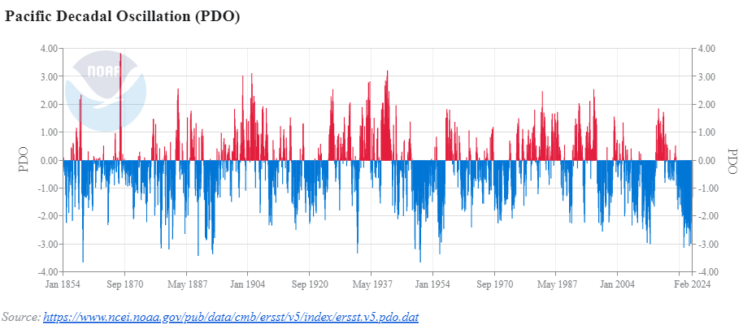
PDO: Medium-Term Environmental Forcing
August 1998

Slide 15
Temporal Change in WCNPO Striped Marlin Recruitment

Slide 16
Estimating When the Change Occurred

Slide 17
Recruitment: Estimating When the Change Occurred
Τ=1993

Slide 18
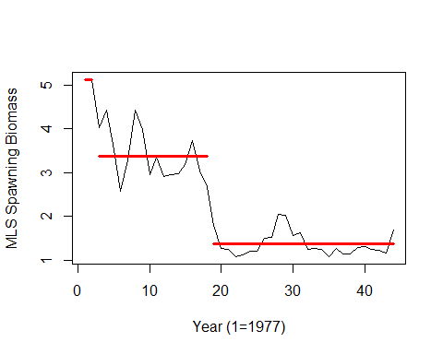
Spawning Stock Biomass: Change Points
Τ₁=1978
Τ₂=1995

Slide 19
Summarize Time Series Results
Recruitment: Nonstationary with probable AR(1) or MA(1+) processes
Spawning Biomass: Nonstationary with probable AR(1) or MA(1+) processes
Recruits Per Spawner: none
ONI: Nonstationary with probable negative serial correlation at lag 2
MEI: Same as ONI but shorter time series
PDO: Nonstationary with probable AR(1) or MA(1) processes
Source: 2024-Feb-6.pptx on https://github.com/PIFSCstockassessments/2024-WCNPO-MLS-Rebuilding

Slide 20
Set Recruitment Model Weights
Use a Tactical Approach (Dormann et al. 2018) Based on Predictive Accuracy
Use out-of-sample predictions for most recent observed recruitments in 2020-2021 (age-1)
Use 5-year ECDF from 2015-2019 for short-term prediction algorithm
Use 20-year ECDF from 2002-2019 for medium-term prediction algorithm
Use expected recruitment from fitted Beverton-Holt curve for long-term prediction

Slide 21
Recruitment Predictions for Age-1 in 2020 and 2021 to Calculate Mean Squared Error and Inverse Variance Weights for each Recruitment Model

Slide 22
Recruitment Model Weights

Slide 23
Recruitment Model Weights

Slide 24
Recruitment Model Weights

Slide 25
Recruitment Model Weights

Slide 26
Recruitment Model Weights

Slide 27
Recruitment Model Weights

Slide 28
Recruitment Model Weights

